Slide 1

Observer Pattern

Slide 2
Payment Status Tracking
In Online Payment systems there may be times where third-party vendors take time to confirm the payment or may need to watch over the payments.
The system will deplete resources if it keeps waiting for confirmation.
A workaround is needed with minimal resources and low Coupling and High Cohesion.

Slide 3
will OBSERVER PATTERN DO?
Use the Observer Pattern for asynchronous payment confirmation.
The payment system (subject) doesn’t wait for confirmation; instead, it notifies observers when the payment status is updated.
Observers (e.g., Notification Service, Fraud Detection): React when notified of payment status updates (success/failure).
Asynchronous Notification: Notifies all observers without blocking resources.

Slide 4
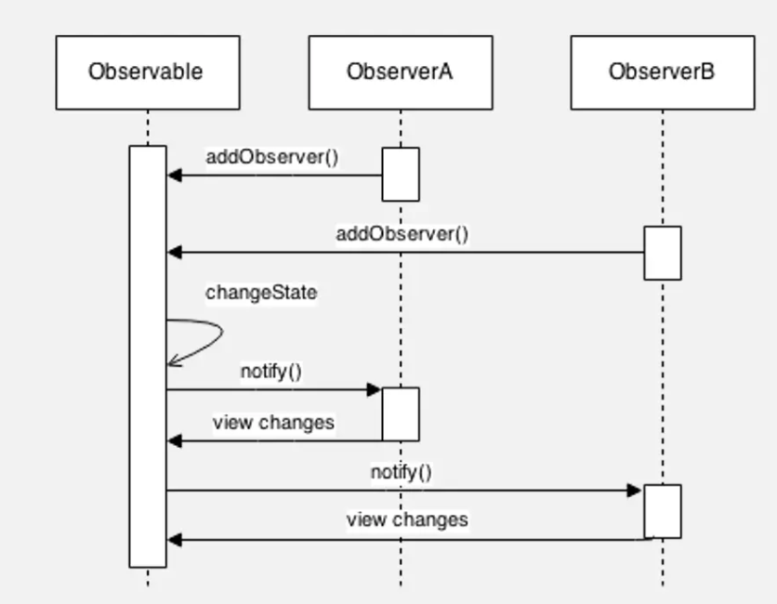
HOW IT HAPPENS

Slide 5
BEnefits
Efficient Resource Usage: System continues processing without waiting for third-party responses.
Low Coupling: Components like fraud detection or notifications are decoupled from the payment process.
Real-time Updates: Observers react instantly to payment updates when received.

Slide 6
THINGS TO HAVE A LOOK AT
Complexity in Handling Multiple Observers: Managing multiple observers may introduce complexity in certain scenarios.
Overhead for Small Systems: For simple systems with minimal components, implementing Observer may introduce unnecessary overhead

Slide 7

THANK YOU

